Slide 1







Launching
Pre-Owned Market-Place
on
himanshuwankhadeh@gmail.com
www.linkedin.com/in/tedhimanshu

Slide 2
















OVERVIEW PROBLEM STATEMENT USER PERSONA PROBLEMS FEATURES SOLUTIONS PRIORITIZATION METRICS GTM STRATEGY
COMPETITORS
Flipkart is an e-commerce platform that offers over 30 million products across 70+ categories. Flipkart, currently 33,000 people strong, has 75 million registered users clocking over 10 million daily visits. Flipkart’s technology has enabled it to deliver 8 million shipments per month.
Binny and Sachin Bansal founded Flipkart in 2007, with headquarters in Bengaluru, India. In 2018, the company was acquired by the giant retail corporation, Walmart.
About Flipkart
IN PRE-OWNED SEGMENT
Some Statistics
$264M
Latest Funding
4.3
Play Store Ratings
200M
Registered Users
30,000
No. of Employees
$1.0-5.0B
Annual Rvenue
Bengaluru
Headquarters

Slide 3
OVERVIEW PROBLEM STATEMENT USER PERSONA PROBLEMS FEATURES SOLUTIONS PRIORITIZATION METRICS GTM STRATEGY
Problem Statement
Why to solve this now?
You have joined Flipkart as Director of Product.
There are several reasons why there is a need for a
second-hand products marketplace:
1.Affordability: Second-hand products are generally cheaper
than brand new ones. They offer a cost-effective way for
people to obtain items they need without breaking the bank.
2.Sustainability: By giving old items a new
lease of life, we can reduce the number of items that end up
in landﬁlls, saving natural resources and reducing our carbon
footprint.
3.Accessibility: Second-hand products marketplaces provide a
platform for people to buy and sell items they no longer need,
making it easier for people to access a wider range of
products. This is particularly useful for those who live in
areas where there are limited options for shopping.
4.Unique ﬁnds: Second-hand products marketplaces offer a
treasure trove of unique and interesting items that are no
longer available in stores.
You have released that the major competition Flikpart receives is not just only from Amazon & Meesho, but pre-owned marketplaces such as Facebook marketplace, Olx, and Whatsapp communities.
You feel it’s time you onboard such sellers who only deal in pre-owned market and target users who want to buy such products, with the trust and safety of Flipkart.

Slide 4

OVERVIEW PROBLEM STATEMENT USER PERSONA PROBLEMS FEATURES SOLUTIONS PRIORITIZATION METRICS GTM STRATEGY
Market Sizing
According to a report by OLX India, the online classiﬁeds platform, the second-hand market in India is expected to reach $45 billion by 2025.
The used car market in India is one of the largest in the world, with estimates suggesting that over 4 million pre-owned cars are sold in the country every year. The used smartphone market in India is also growing rapidly, with reports suggesting that it is expected to reach $4 billion by 2025.
Similarly, the pre-owned fashion market in India is also growing, driven by increasing awareness about sustainability and the circular economy. According to a report by McKinsey & Company, the second-hand clothing market in India is expected to reach $40 billion by 2025.

Slide 5

OVERVIEW PROBLEM STATEMENT USER PERSONA PROBLEMS FEATURES SOLUTIONS PRIORITIZATION METRICS GTM STRATEGY
Aarushi
23 yearrs old
Graduate
Rohit
30 years old Environmental engineer
Anjali
28 years old Freelance writer
Aarushi just completed her B.Com. She lives in Pune and is a Bookworm. She reads a lot but each book costs her around ₹500 and the second hand price is also usually ₹300. This is a lot of spending if she reads one book every week.
Aayush is a 28-year-old software engineer who loves luxury watches. He enjoys browsing through Insta pages and webpages to find one-of-a-kind pieces that he can add to his collection.
Motivations
Reducing waste
Conserving resources
Supporting sustainable practices
Core Needs
A wide selection of preloved products to
choose from.
Detailed information about the product's
environmental impact.
Quality assurance and trust in the seller's
sustainability practices.
Pain Points-
Limited availability of sustainably-sourced or
eco-friendly products.
Uncertainty about the quality and condition
of preloved products.
Higher prices for sustainably-sourced or eco-
friendly products.
Anjali is a 35-year-old freelance writer who loves collecting unique items. She enjoys browsing through flea markets and thrift stores to find one-of-a-kind pieces that she can add to her collection.
Motivations
Finding unique and one-of-a-kind items.
Building a collection.
Discovering hidden gems.
Core Needs
A wide selection of vintage and unique items
to choose from.
Detailed product descriptions and photos to
evaluate condition and authenticity.
Trustworthy sellers with a reputation for
selling unique and quality items.
Pain Points-
Limited availability of rare or specific items.
Difficulty in assessing the condition and
authenticity of preloved products.
High prices for unique or vintage items.
Core Needs-
-A marketplace where she can exchange books with anyone in this country
-Exchange books for low cost
Pain Points-
-Purchasing a large number of books can be costly, particularly for those on a tight budget.
-Having a large collection of books can take up a lot of physical space
-Cant exchange books with friends as it is not necessary that everyone will have the book she wants.

Slide 6
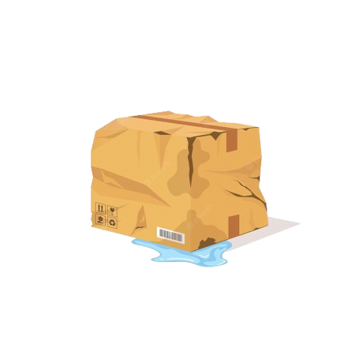

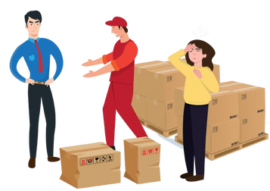
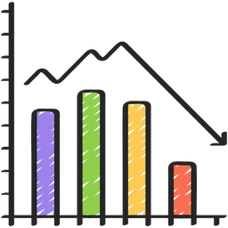

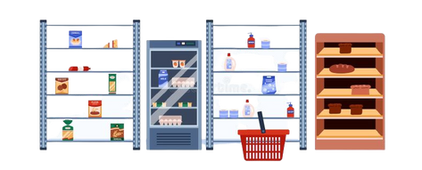
OVERVIEW PROBLEM STATEMENT USER PERSONA PROBLEMS FEATURES SOLUTIONS PRIORITIZATION METRICS GTM STRATEGY
PROBLEM 1 - HIDDEN DAMAGE
PROBLEM 2 - POTENTIAL FOR FRAUD
Pre-owned products may have hidden damage or wear and tear that may not be immediately apparent, which could lead to issues down the line.
There is always a risk of fraud when buying pre-owned items from an individual seller, particularly if you’re buying online.
PROBLEM 3 - SHIPPING $ HANDLING ISSUES
PROBLEM 4 - PRICE INFLUCTUATIONS
When purchasing second-hand items, buyers may encounter shipping and handling issues, such as delayed delivery or damaged items.
The prices of used items can vary based on condition, rarity, and demand, making it difficult for buyers to determine fair market value and potentially resulting in overpaying or underpaying for an item.
PROBLEM 5 - NO WARRANTY
PROBLEM 6 - LIMITED OPTIONS
Unlike new products, pre-owned items typically don’t come with a warranty or guarantee, so you’re taking a risk that the product may not work as expected or could break soon after purchase.
Buyers may not find what they want or may have to settle for a less ideal item.

Slide 7

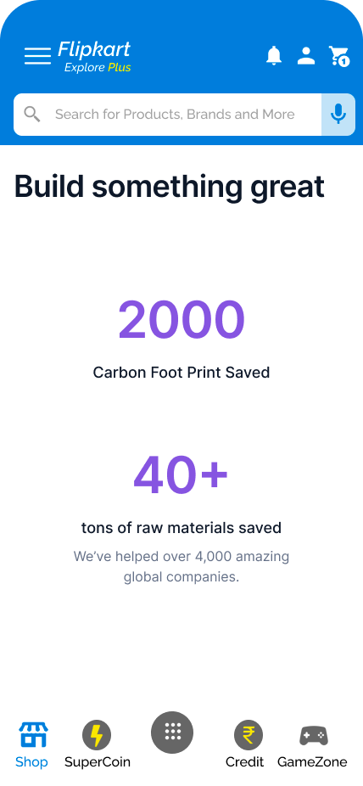

OVERVIEW PROBLEM STATEMENT USER PERSONA PROBLEMS FEATURES SOLUTIONS PRIORITIZATION METRICS GTM STRATEGY
Important Features:
Social Impact Score:
To appeal to users who are socially conscious, we will offer a social impact score that rates the products’s environmental and social impact.
This feature would provide users data with more transparency about the product’s impact on the environment and society.
Authentication Badge:
We will introduce an authentication process for sellers dealing in pre-owned goods. This process will include the verification of products before listing them on the platform.
We will provide an authentication badge to the products that have been authenticated by Flipkart.
This badge will give the buyers the assurance that the product they are buying is authentic and of high quality.

Slide 8
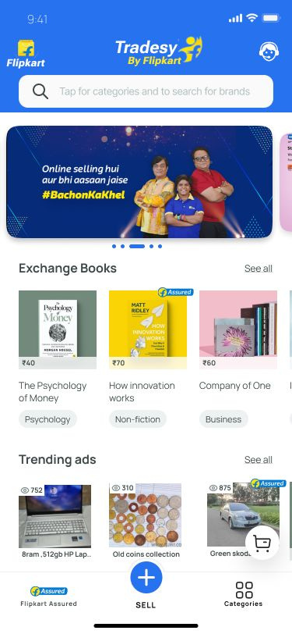

OVERVIEW PROBLEM STATEMENT USER PERSONA PROBLEMS FEATURES SOLUTIONS PRIORITIZATION METRICS GTM STRATEGY
Tradesy By Flipkart
Overview:
Tradesy is a marketplace for pre-owned products. Since this marketplace is offered by Flipkart, it ensures that the products are of good quality and are sold by genuine sellers.
Value To Users!
Users can easily find and access a range of affordable products that they may not have been able to afford otherwise.
Users will be able to better understand why they should choose pre-owned products.
Users can be assured they are buying good quality products.
Advantages:
One-stop solution for pre-owned products Assurance of quality.
Multiple options to choose from.
Fair prices.
Genuine retailers.
Delivery of product at your doorstep.
Value To Business!
Easy access to preowned products will increase purchases.
Showing products' journeys will assure users that only authentic goods are sold on the platform.
Recommendations will increase user satisfaction.

Slide 9
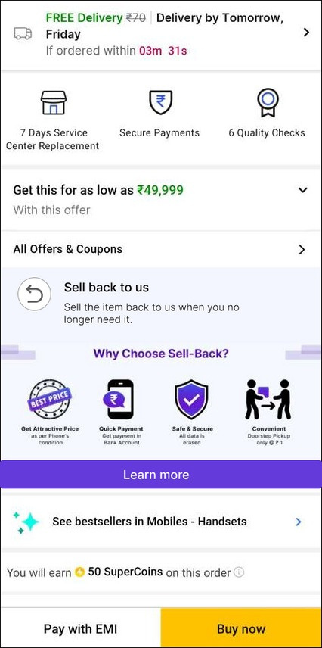
OVERVIEW PROBLEM STATEMENT USER PERSONA PROBLEMS FEATURES SOLUTIONS PRIORITIZATION METRICS GTM STRATEGY
Integrating Sell-Back Program
What Is It?
Flipkart offers a Sell-back program whereby users can sell their old mobiles and laptops to Flipkart, or exchange them with new ones.
The program is currently open only for mobiles and laptops.
We will be making use of Sell-back program by integrating with it preowned category goods to attract more buyers.
Value To Business!
None of the competitors of Flipkart has yet launched the sell-back program in the preowned category, so integrating the program will help Flipkart differentiate itself from competitors, attracting users to buy from Flipkart instead of other platforms.
Integrating the program will increase customer engagement and retention.
Increase in customer loyalty.
This will further help Flipkart reduce its carbon footprint.
How It Will Work?
We will show about sell-back program on the product description page.
The program will allow users to sell back the preowned product, they are currently buying from Flipkart when they no longer need it.
The Learn More CTA will redirect users to a page giving more information about the program and how users can leverage it.
When selling back, the user will have to provide their Order ID to get the sell-back price of the item.

Slide 10
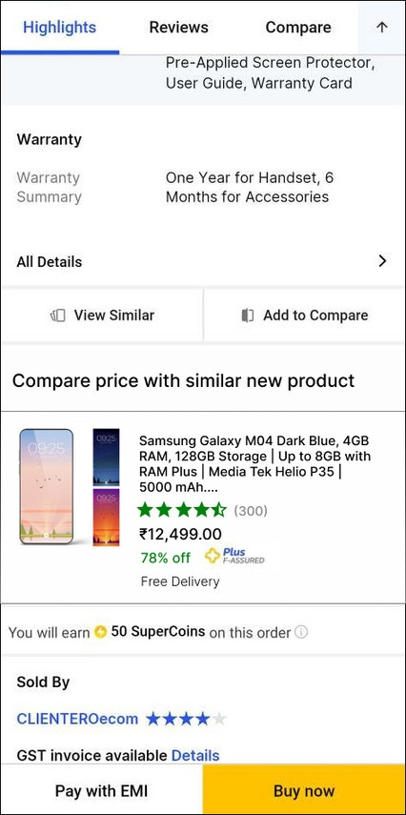
OVERVIEW PROBLEM STATEMENT USER PERSONA PROBLEMS FEATURES SOLUTIONS PRIORITIZATION METRICS GTM STRATEGY
Price Comparision
What Is It?
We will show users the price of the new product similar to what they are viewing.
This feature will help users determine if the pre-used product is a good deal or if they should buy a new product.
Value To Users!
Users will be able to make the right decision between choosing a new good and pre-used good.
Users can identify cost-saving opportunities.
Users will be able to make informed purchasing decisions based on the price comparison.
Price comparisons will provide users with transparency into the value proposition of preowned products.
Users will have greater confidence in their purchasing decisions.
Users can discover new products that fit their preferences and budget.
How It Will Work?
Users will be shown the price of a similar new product
on the product description page of the preowned product. Along with the price, we will also mention the product title, image, rating, no. of ratings, offer, authentication badge, and other offers.
Clicking on the product, users will be redirected to its description page.

Slide 11
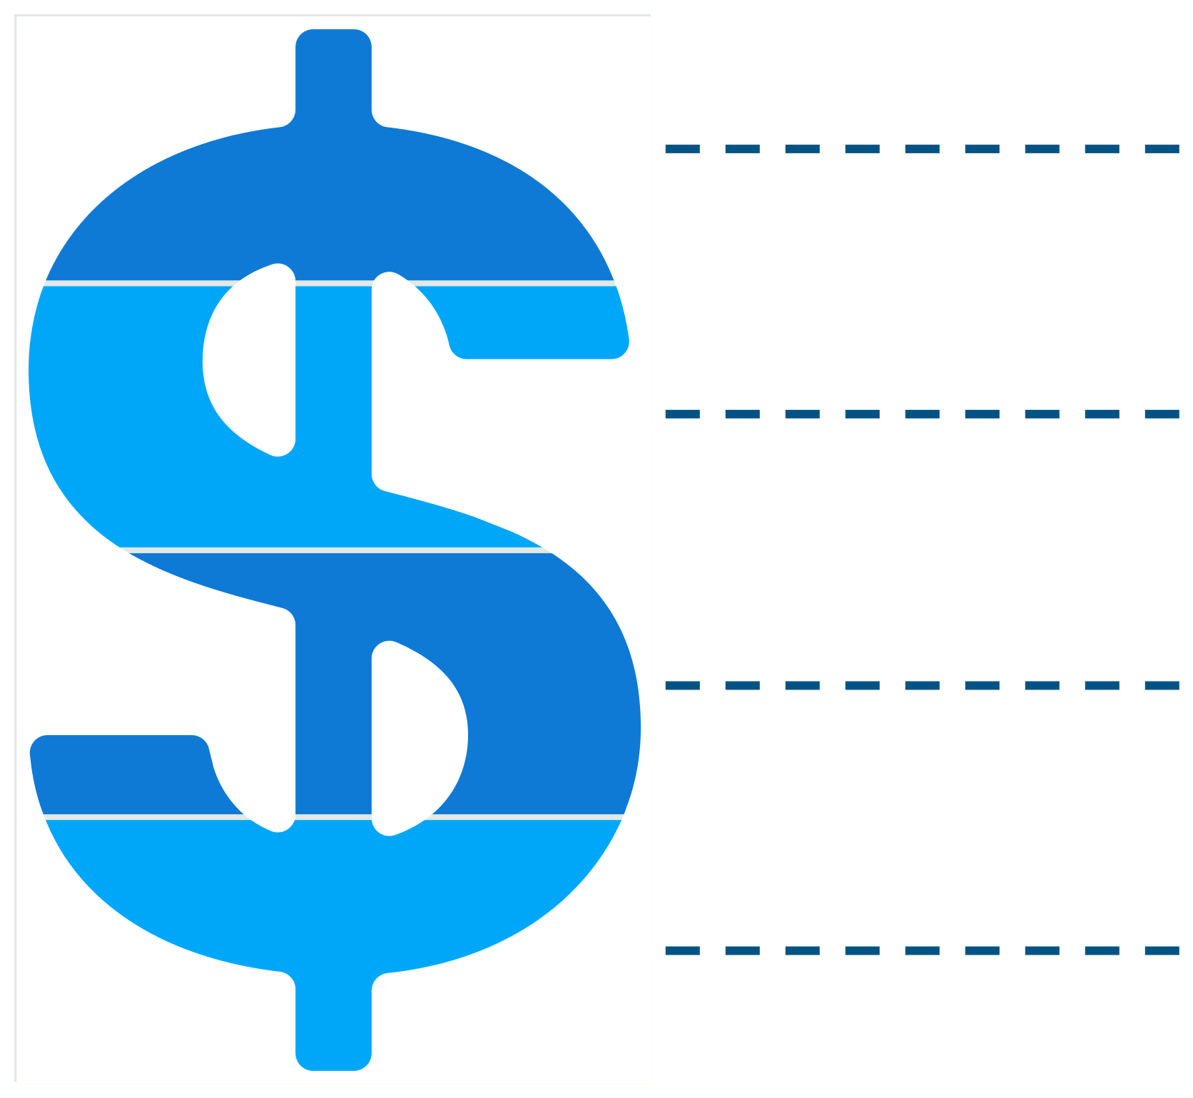
OVERVIEW PROBLEM STATEMENT USER PERSONA PROBLEMS FEATURES SOLUTIONS PRIORITIZATION METRICS GTM STRATEGY
MONETIZATION STRATEGIES
Loyalty Programs: Flipkart can introduce loyalty programs for customers who regularly purchase pre-owned products. This can include rewards points that can be redeemed for discounts, free shipping, or other rewards.
Subscription-Based Model: Flipkart can introduce a subscription-based model for pre- owned products where customers pay a monthly fee to access exclusive deals, discounts, and personalized recommendations. This can help generate recurring revenue for Flipkart and incentivize customers to purchase more pre-owned products.
Recommerce Partnership: Flipkart can partner with brands and manufacturers to offer recommerce programs, where customers can trade-in their old products for discounts on new ones. Flipkart can earn a commission on each trade-in transaction and generate revenue from the sale of pre-owned products.
Product Bundling: Flipkart can offer product bundles that include a mix of new and pre- owned products at a discounted price. This can encourage customers to try pre-owned products and generate revenue from the sale of new products as well.

Slide 12



OVERVIEW PROBLEM STATEMENT USER PERSONA PROBLEMS FEATURES SOLUTIONS PRIORITIZATION METRICS GTM STRATEGY
Solution
Reach
Impact (1-3)
Confidence
Effort
(1-3)
Score
Priority
Tradesy By Flipkart
100%
3
90%
3
0.9
1
Integrating Sell-Back Program
80%
3
90%
3
0.72
2
Price Comparison
90%
2
80%
2
0.72
2
Social Impact Score & Authentication Badge
70%
1
80%
2
0.28
3

Slide 13



OVERVIEW PROBLEM STATEMENT USER PERSONA PROBLEMS FEATURES SOLUTIONS PRIORITIZATION METRICS GTM STRATEGY
NORTH STAR METRIC
Pre-Owned Product sales revenue growth rate over a quarter.
AWARENESS
SATISFACTION
No. of visits on Flipkart Tradesy page per month.
% of visits through organic results per month.
% of visits through inorganic results per month.
Ranking of Flipkart Tradesy on searches related to pre-owned products.
Net promoter score.
CSAT score.
RATINGS AND REVIEWS
AQUISITION & CONVERSION
No. of new customers acquired through preowned products.
% of users who visit the preowned product category page and go on to make a purchase.
Average order value of preowned product purchases.
RETENTION
% of users buying again per month.
ENGAGEMENT
No. of orders per user per month.
The average quantity of products added to the basket per month.
Bounce rate per product or category page.
No. of users posting reviews on resellers.

Slide 14

OVERVIEW PROBLEM STATEMENT USER PERSONA PROBLEMS FEATURES SOLUTIONS PRIORITIZATION METRICS GTM STRATEGY
PITFALLS
MITIGATION
Since the products are pre-owned, there might be defects in the products being sold which might be detected later on regular usage by the buyer. Such unhappy buyers can create negative word of mouth for the Tradesy as well as Flipkart
There is a possibility that the books put in the exchange section might be in a very bad condition and hence the user might not ﬁnd it worth the money.
Sellers might not post the real image of the product. They can edit and present a better picture of the photograph for selling the product which might not meet the expectations of the buyer.
For price comparison, all new products may not have enough ratings.
Uncommon categories such as antiques or kids ride-on, may not have enough product listings.
Develop flexible return and refund policies that protect the interests of buyers. This can include hassle-free return options if the product doesn't meet the described condition. Offer limited warranties or guarantees for certain pre-owned products
Establish clear quality standards for books that can be listed in the exchange section. Specify criteria for acceptable conditions, such as minimal wear and tear, no missing pages, and no significant damage.
Implement a quality control program to verify product listing accuracy through random or systematic checks. Consistent misrepresentation by sellers may result in penalties or removal from the platform
Omit showing ratings if enough rating is not present.
Encourage specialized sellers through incentives and support, and promote their products through targeted marketing campaigns.

Slide 15
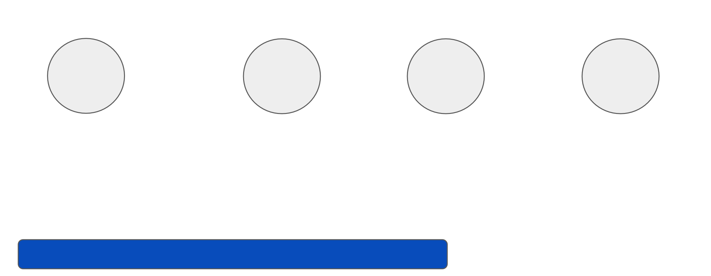



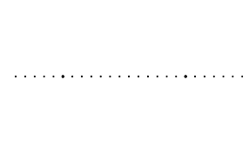













OVERVIEW PROBLEM STATEMENT USER PERSONA PROBLEMS FEATURES SOLUTIONS PRIORITIZATION METRICS GTM STRATEGY
Go-To-Market Strategy
Market Research
Feature Development
Beta Launch
Feedback
Final Release
Understand the users who prefer buying second hand products by conducting primary and secondary research along with competitor analysis.
Design a separate section for second hand goods. That feature must help sellers ﬁnd the right buyer as well as provide ﬂipkart assurance to buyers.
Developed Beta version of the features which will be released to a small set
of users to collect initial performance data and user feedback
Work on the suggestions and feedback given by the users before in the beta version and that is how ﬁnal version of the features will be developed for the ﬁnal release.
Fix all the bugs, rework on the feedback, and then launch the ﬁnal version. Improvements
will be advertised and communicated to users through notiﬁcations and app update information.
Phase-wise Roll out:
Roll out the pre-owned marketplace initially with a select few categories such as smartphones, laptops, and home appliances. Subsequently, broaden the categories to incorporate fashion, accessories, and furniture. Listing pre-owned items in regular search results.
Generating Awareness:
Promote a pre-owned marketplace through targeted Email, SMS, and WhatsApp campaigns to selected users. Highlight the changes with a banner on the app's home screen to create in-app awareness. Use social media handles to announce the phase-wise rollout of the pre-owned marketplace.
Collaborate with existing pre-owned sellers on social media platforms and leverage their network to promote Flipkart's pre-owned store, thereby increasing its visibility.
Leverage social media platforms like Instagram, Twitter, and Facebook to promote the pre-owned store. Use creative visuals and engaging content to grab customers' attention and showcase the unique features of the store.
Provide special discounts and deals to customers who shop from the pre-owned store. This can help incentivize customers to try shopping from the store and build trust in the brand.

Slide 16

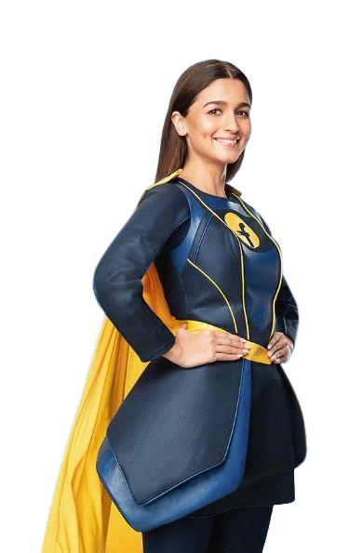
Thank You

